Slide 1
Probability and Statistical Inference
Correlation
Sources used in creation of this lecture:
Statistics and Data Analysis, Peck, Olsen and Devore; Discovering Statistics Using R, Field, Miles and Field; Understanding Basic Statistics, Brase and Brase;SPSS Survival Manual, Julie Pallant

Slide 2
Before Inferential Statistics…
We need to establish evidence to support going ahead with building a predictive model
If we are asserting a relationship
We need to investigate if there is any evidence of a relationship using the appropriate test and make a decision based on the results (strength, direction etc.)
If we are asserting a differential effect for different groups
We need to investigate if there is any difference using the appropriate test and make a decision based on the result

Slide 3
The General Linear Statistical Model
Concepts of interest (measured by their variables) are hypothesised to be related to each other in some way
The goal is to summarize or describe accurately what is happening in the data.
Easiest way to think about it is for bivariate data
Looking to model the pattern in ordered pairs where each member of the pair is the value of one of the variables of interest
Our statistical model takes the form of a mathematical equation
Outcome_{i} = model + error_{i (}i = ith case)
Outcome in the data we observed = model we built + an error
In the linear model
Trying to fit a line to it to model the pattern
Using the equation of a line y = b₀ + b₁x + e
Where y is our dependent (or outcome) variable and x is the independent (or predictor)
b₀ is the intercept (value of y when x is 0)
e is the error term - the degree to which the line is in error in describing each data point

Slide 4
Correlation - what are we interested in?
Direction
Positive or negative
Slope of the line
Strength
How close are the data points to the line
Very close = strong
Very dispersed = weak

Slide 5
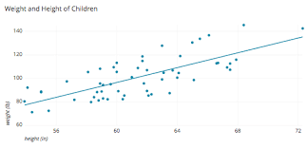
Scatterplots
When to Use
Bivariate numerical data (two variables)
Plot the relationship between two variables
One independent, one dependent
Collection of ordered pairs
How to construct
Draw a horizontal scale and mark it with appropriate values of the independent variable
Draw a vertical scale and mark it appropriate values of the dependent variable
Plot each point corresponding to the observations
To describe
Comment the relationship between the variables

Slide 6
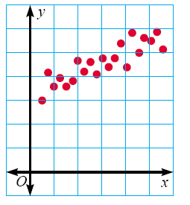
Positive Correlation
If the x-coordinates and the y-coordinates both increase, then it is POSITIVE CORRELATION.
This means that both are going up, and they are related.

Slide 7
Positive Correlation
If you look at the age of a child and the child’s height, you will find that as the child gets older, the child gets taller.
Because both are going up, it is positive correlation.
Age | 1 | 2 | 3 | 4 | 5 | 6 | 7 | 8
Height | 25 | 31 | 34 | 36 | 40 | 41 | 47 | 55

Slide 8
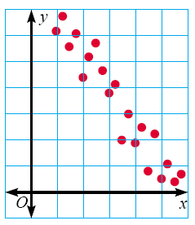
Negative Correlation
If the x-coordinates and the y-coordinates have one increasing and one decreasing, then it is NEGATIVE CORRELATION.
This means that 1 is going up and 1 is going down, making a downhill graph.
This means the two are related as opposites.

Slide 9
Negative Correlation
If you look at the age of a car and its value, you will find as the car gets older, the car is worth less.
This is negative correlation.
Age of car | 1 | 2 | 3 | 4 | 5
Value | €30,000 | €27,000 | €23,500 | €18,700 | €15,350

Slide 10
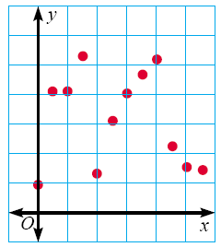
No Correlation
If there seems to be no pattern, and the points looked scattered, then it is no correlation.
This means the two are not related.

Slide 11
No Correlation
If you look at colour of boots a premier league footballer wears and their scoring average, you will find that there is no correlation between the two.

Slide 12
Scatterplots
Which scatterplots below show a linear trend?
a)
c)
Negative
Correlation
e)
Positive
Correlation
b)
d)
f)
Constant
Correlation

Slide 13
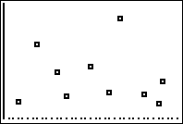
Suppose we found the age and weight for each person in a sample of 10 adults. Is there any relationship between the age and weight of these adults?
Create a scatterplot of the data below.
There does not appear to be a relationship between age and weight in adults.
Do you think there is a relationship? If so, what kind? If not, why not?
Weight
Age
Age | 24 | 30 | 41 | 28 | 50 | 46 | 49 | 35 | 20 | 39
Wt | 256 | 124 | 320 | 185 | 158 | 129 | 103 | 196 | 110 | 130
Notes:
Students should doubt that any relationship exists between age and weight.
Ask students what feature of the scatterplot indicates that there is little to no relationship between age and weight in adults.

Slide 14
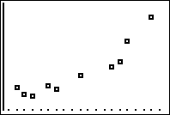
Suppose we found the height and weight for each person in a sample of 10 adults. Is there any relationship between the height and weight of these adults?
Create a scatterplot of the data below.
Weight
Do you think there is a relationship? If so, what kind? If not, why not?
Height
Is it positive or negative? Weak or strong?
Ht | 74 | 65 | 77 | 72 | 68 | 60 | 62 | 73 | 61 | 64
Wt | 256 | 124 | 320 | 185 | 158 | 129 | 103 | 196 | 110 | 130
Notes:
Have students explain what features of the graph indicate that there is a relationship between height and weight in adults.

Slide 15
Correlation
The relationship between bivariate numerical variables
May be positive or negative
May be weak or strong
What feature(s) of the graph would indicate a weak or strong relationship?
What does it mean if the relationship is positive?
negative?
Notes:
A positive relationship is one where as x increases, y increases.
A negative relationship is one where as x increases, y dereases.

Slide 16
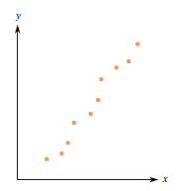
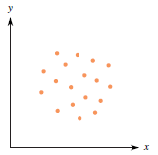
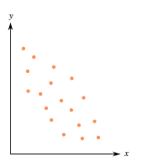
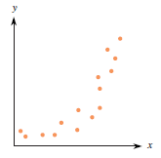
Identify the strength and direction of the following data sets.
Set A
Set B
Set C
Set D
Set D shows a strong, positive curved relationship.
Set A shows a strong, positive linear relationship.
Set B shows little or no relationship.
Set C shows a weaker (moderate), negative linear relationship.
Notes:
Direction should be positive or negative (or none)
Strength should be weak or strong
Be sure to ask what feature(s) of the graph indicate the relationship.
Set A has a strong, positive linear relationship.
Set B shows little or no relationship.
Set C has a moderate, negative linear relationship.
Set D has a strong positive curved relationship.

Slide 17
Simple Example
Suppose we want to look at children’s maths scores at age 16 and their achievement of a standard maths test at aged 7
We are interested to see if the score a child achieves at age 7 is related to the score they achieve at age 16
And if so what is the direction and strength of the relationship

Slide 18
Simple Example
y = b0 + bx + e
‘y’ is the outcome variable (in this case GCSE Score) – the dependent variable
‘
y
b0
x
Relationship between Maths score age 7 with GCSE result at age 16 (for 25 students)

Slide 19
Simple Example
y = b0 + bx + e
‘x’ is the independent variable (in this case Maths Score aged 7)
y
b0
x
Relationship between Maths score age 7 with GCSE result at age 16 (for 25 students)

Slide 20
Simple Example
y = b0 + bx + e
‘b0’ is the intercept or the point where the line crosses the y-axis (y value when x =0)
y
b0
x
Relationship between Maths score age 7 with GCSE result at age 16 (for 25 students)

Slide 21
Simple Example
y = b0 + bx + e
‘b’ is the gradient of the line
Represents the amount that the outcome variable changes for one unit change in the independent variable
(e.g. for every one percentage point increase in a child’s Maths Test score, the line suggests that the child’s GCSE Score increases by ‘b’ points);
y
b0
x
Relationship between Maths score age 7 with GCSE result at age 16 (for 25 students)

Slide 22
Simple Example
y = b0 + bx + e
If the line did completely model the data then all of the points would rest exactly on the line.
e is basically the vertical distance between each point and the line itself.
Model is a best fit.
‘e’ obviously varies.
Without any further information about confounding variables we cannot explain this variation – so we include it as an error.
y
b0
x
Relationship between Maths score age 7 with GCSE result at age 16 (for 25 students)

Slide 23
Simple Example
y = b0 + bx
However, if we are dealing with a normal distribution these error terms will cancel each other out and we do not need to include it in the equation.
y
b0
x
Relationship between Maths score age 7 with GCSE result at age 16 (for 25 students)

Slide 24
We are really looking at Co-variation
World is full of co-variation
Nutrition and growth
Pollen and bees
Violence on TV and violence in Society ?

Slide 25
Parametric v Non-parametric
Parametric
Make assumptions about the population from which the sample is taken
Shape of the population (normally distributed)
Non-parametric
Do not make assumptions about the population and its distribution
Tolerant set of tests which don’t expect your data to anything fancy
Not high-powered and don’t promise more than they can deliver
May fail to detect differences that exist
Use for nominal or ordinal data
Use for small samples
Use for skewed data

Slide 26
What is a Correlation?
It is a way of measuring the extent to which two variables are related.
It measures the pattern of values across variables.
It is used to describe the strength and direction of the linear relationship between two variables.
Pearson Correlation (Parametric)
Spearman Rank Order Correlation (Non-Parametric)

Slide 27
Measuring Relationships
We are investigating whether as one variable increases, the other increases, decreases or stays the same.
We assess the relationship via the correlation coefficient.
And by calculating the Covariance.
We look at how much each score deviates from the mean.
If both variables deviate from the mean by the same amount, they are likely to be related.
We can look at a bi-variate correlation or a partial correlation
Bi-variate – two variables
Partial – two variables while controlling for another

Slide 28
Linear Correlation
The extent to which two variables have a straight line relationship
We are interested in
Direction (+/-)
Strength (Weak/Moderate/Strong)
Values closer to +1 or -1 indicate stronger relationship
Statistical Significance
Likelihood the relationship we observe is occurring due to chance

Slide 29
Modeling Relationships
First, look at some scatterplots of the variables that have been measured.
Outcome_{i} = (model ) + error_{i}
Outcome_{i} = (bX_{i} ) + error_{i}

Slide 30
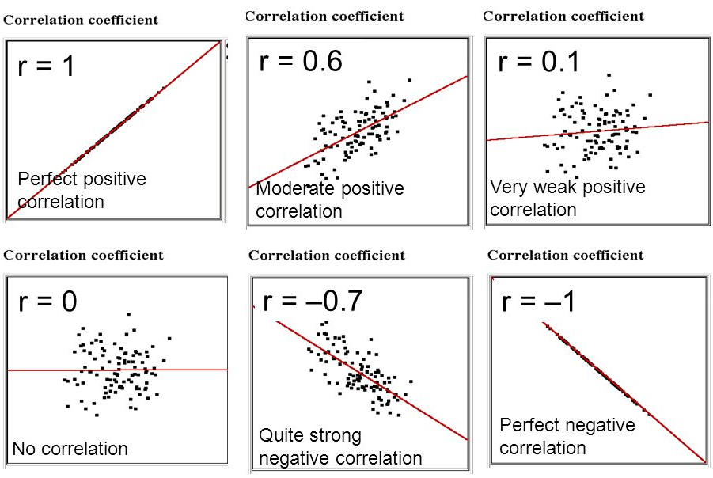
Strength of relationships
Notes:
Appreciation of Norwegian Black metal Band Dimmu Borgin against age

Slide 31
Assumptions Parametric Correlation
Pearson’s Correlation
Level of measurement
Interval or ratio
Exception:
You can have one independent variable with two categories (e.g. gender) and one continuous dependent.
Caveat: you must have approximately the same numbers of cases for each category of the categorical variable
Spearman’s Rho can be used for ordinal or ranked data

Slide 32
Assumptions Parametric Correlation
Related Pairs
Each case must provide a score on the two independent variables
Independence of observations
Each measurement must not be influenced by any other
E.g. if studying TV habits on children and all children are from same family then behaviours of one child are likely to affect all so observation is unlikely to be independent

Slide 33
Assumptions for Parametric Correlation
Normality
Scores should be normally distributed
Inspect histograms for each variable
Linearity
There must be a linear relationship between the two variables
Inspect a scatterplot and you should see a straight line not a curve
Homoscedasticity
Variability of variable 1 should be similar to variable 2
Check scatterplot
Looking at distance between the points to that straight line.
The shape of the scatterplot should be tube-like or rectangular in shape.
If the shape is cone-like, then homoscedasticity would not be met.
It is a matter of degree

Slide 34
Homoscedasticity
We are interested in the relationship between income levels and spending on gadgets.
We want to investigate if income level could be considered to predict the level of spending on gadgets.
We find a strong, positive association between income and spending.
So far so good.
But when we look at our pattern graphically we find the levels of spend are low for low incomes
This makes sense people with low incomes don’t spend lots of money on luxury items
And we find the level of spend varies for those with high incomes
Again this makes sense, some people are more moderate in their spending than others
We therefore have heteroscedasticity which means that it doesn’t make sense to base any prediction based on this relationship

Slide 35
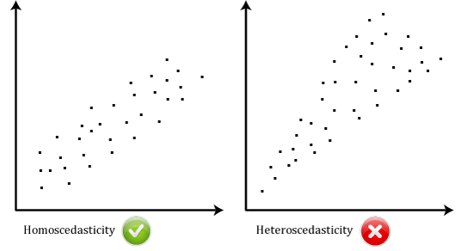
Homoscedasticity

Slide 36
Getting Started With Analysis
Inspect your data
Generate your descriptive statistics
Generate your visuals (graphs)
Make decisions about normality
Choose the correct tests

Slide 37
Example Pearson Correlation
For the dataset survey.sav (SPSS), survey.dat (R)
SPSS Survival Manual 6th Edition Julie Pallant
http://spss.allenandunwin.com.s3-website-ap-southeast-2.amazonaws.com/data-files.html#.Wb0vvnWP-po
Dataset created from a designed to explore the factors that impact on respondents’ psychological adjustment and wellbeing.
R dataset has been made available to you (survey.dat)
To load the data in R the command is (as usual change the location to reflect where you have the file saved
survey <- read.table("survey.dat”)
PSIWeek3-Lecture.rmd contains all the commands.

Slide 38
Example Pearson Correlation
Question:
“Is there a relationship between respondents’ feelings of control and their level of perceived stress?
Variables:
Feeing of control
tpcoiss
Total PCOISS derived from the PCOISS questionnaire (tpcoiss)
Dependent variable
Total Perceived Stress
tpstress
Derived from the perceived stress questionnaire
Independent variable

Slide 39
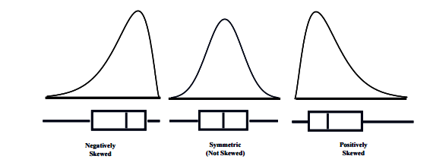
Plots and Histograms

Slide 40
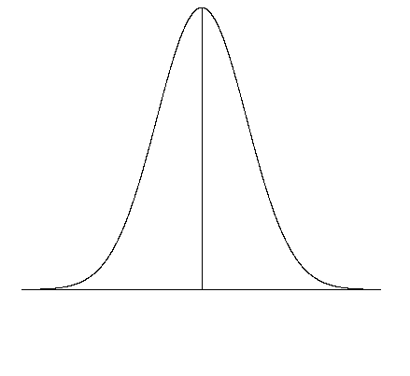
Normal Quantile Plot
Basically compares the spacing of our data to what we would expect to see in terms of spacing if our data were approximately normal.
If our data is approximately normally distributed we should spacing similar to what is shown on the normal curve on the right. Very few observations in both tails and increasingly more observations as we move towards the mean from either side. Also remember the spacing must be symmetric about the mean.

Slide 41
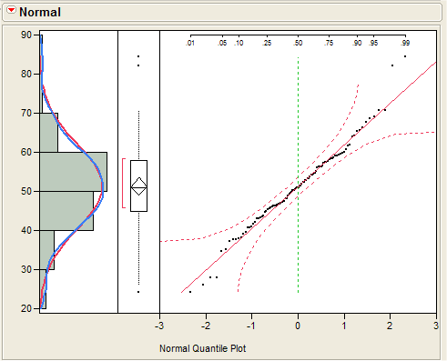
Normal Quantile Plot
THE IDEAL PLOT:
Here is an example where the data is perfectly normal. The plot on right is a normal quantile plot with the data on the vertical axis and the expected z-scores if our data was normal on the horizontal axis.
When our data is approximately normal the spacing of the two will agree resulting in a plot with observations lying on the reference line in the normal quantile plot. The points should lie within the dashed lines.

Slide 42
Normal Quantile Plot
THE IDEAL PLOT:
Here is an example where the data is perfectly normal. The plot on right is a normal quantile plot with the data on the vertical axis and the expected z-scores if our data was normal on the horizontal axis.
When our data is approximately normal the spacing of the two will agree resulting in a plot with observations lying on the reference line in the normal quantile plot. The points should lie within the dashed lines.

Slide 43
Detrended Q-Q Plot
In the Detrended Plot, the horizontal line at the origin represents the quantiles that we would expect to see if the data were normal;
The dots represent the magnitude and direction of deviation in the observed quantiles.
Each dot is calculated by subtracting the expected quantile from the observed quantile.
(This implies that if a dot is below the trend line on the Normal Q-Q plot, it will appear above the trend line on the Detrended Normal Q-Q plot, because observed - expected > 0.)

Slide 44
How do I inspect a scale variable?
Generate summary statistics
Make sure you include skewness and kurtosis
Generate a histogram with a normal curve showing
Generate a Q-Q plot
Review your statistics and plots to see how far away from normal your data is

Slide 45
How do I inspect a scale variable in R?
Use packages pastecs, ggplot2 and semTools
Install them using the install.packages e.g. install.packages(“pastecs”)
Thereafter tell R you want to use them e.g. library(pastecs)
Statistical summary
library(pastecs)
Use stat.desc function form
Will give you a set of summary statistics for a variable
stat.desc(varname, basic=F)
Make sure you include the basic switch=F to ensure you don't get scienfitic notation
Skewness and kurtosis with standard error Use package semTools
library(semTools)
skew(varname)
kurtosis(varname)
(we need the standard error to facilitate creating standardised score of skewness and kurtosis)

Slide 46
How do I inspect a scale variable in R?
Create a histogram
library(ggplot2)
g <- ggplot(survey, aes(x=varname))
#Change the label of the x axis
gg <- gg + labs(x=“The Label of the X Axis")
#manage binwidth and colours
gg <- gg + geom_histogram(binwidth=2, colour="black", aes(y=..density.., fill=..count..))
gg <- gg + scale_fill_gradient("Count", low="#DCDCDC", high="#7C7C7C")
qqnorm will create a qqplot
qqnorm(varname)
qqline(varname, col=2)
Qqline will show a line on the plot

Slide 47
Tests of Normality
As with all estimates we are unlikely to ever see the values of zero in either skewness or kurtosis statistics for the standardised scores of the variable of interest.
The real question is whether the given estimates vary significantly from zero.
We need to look at the standard error of skewness and kurtosis.
We are looking for is whether the value of ‘zero’ is within the 95% confidence interval.

Slide 48
Confidence Intervals
CI represents a range of values between which we think a population value will fall
Suppose we are looking at our fish in Lough Mask
True mean
15 thousand fish
Sample mean
17 thousand fish
Interval estimate
12 to 22 thousand(contains true value)
12 thousand < µ < 22 thousand
16 to 18 thousand (misses true value)
CIs constructed such that 95% contain the true value.
Confidence intervals for means are intervals constructed using a procedure that will contain the population mean a specified proportion of the time, typically either 95% or 99% of the time.

Slide 49
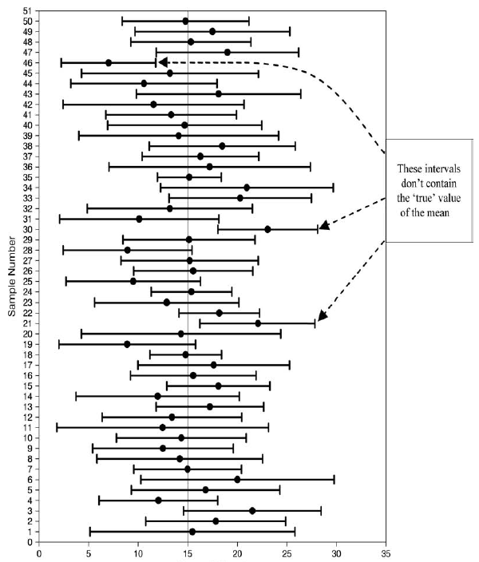
Fish Numbers(thousands)

Slide 50
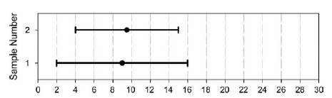
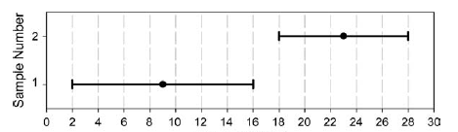
Fish Numbers(thousands)
Fish Numbers(thousands)

Slide 51
How to construct a CI?
Typically look at 95% CI but can also look at 99%
What does this mean?
If we say CI is 95% then if we collected 100 samples, calculated the mean
Then a CI of 95% means we are confident that 95 of these would contain the true mean
When you compute a confidence interval on the mean, you compute the mean of a sample in order to estimate the mean of the population.
Clearly, if you already knew the population mean, there would be no need for a confidence interval.

Slide 52
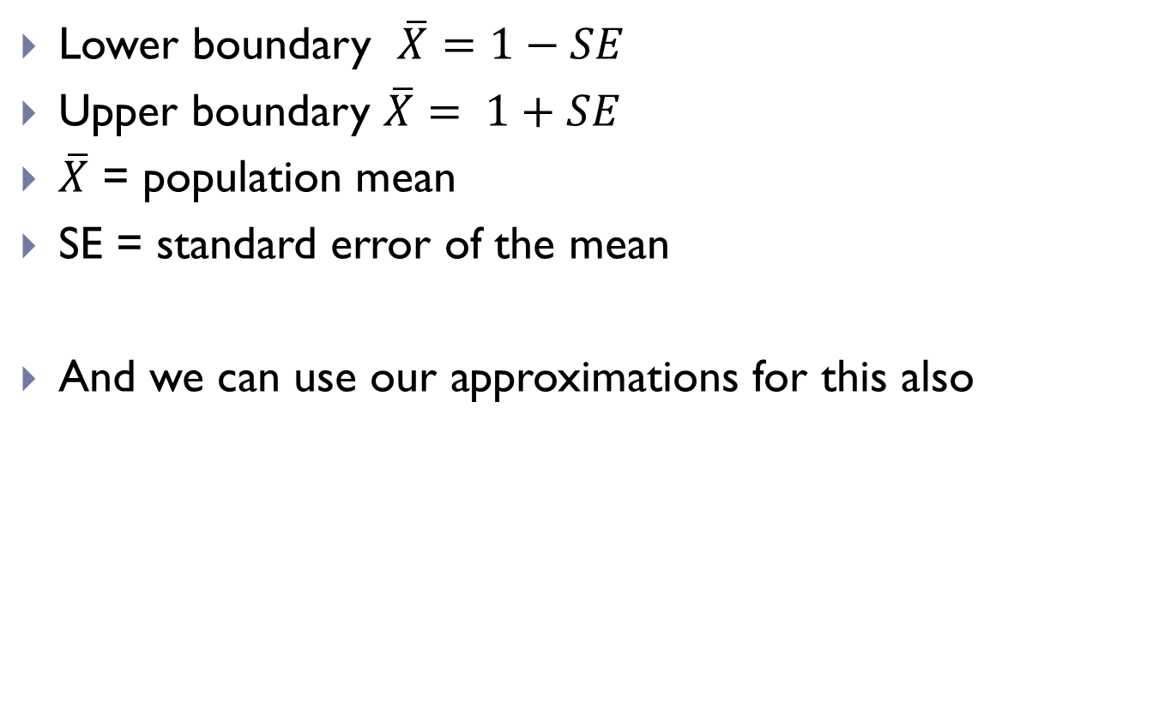
CI
Lower boundary $\overline{X}=1−SE$
Upper boundary $\overline{X}= 1+SE$
$\overline{X}$ = population mean
SE = standard error of the mean
And we can use our approximations for this also

Slide 53
CI
How to calculate?
Need to know the limits within which 95% of the means fall
Go back to the normal distribution – 95% of scores fall between +-1.96
Once we know the mean and standard deviation we can calculate any score and therefore the CI

Slide 54
Skewness and Kurtosis
Standardised scores for skewness and kurtosis between -2 and +2 are considered acceptable in order to prove normal univariate distribution.
George, D., & Mallery, M. (2010). SPSS for Windows Step by Step: A Simple Guide and Reference
Within R use library semTools
skew(survey$tpcoiss)
kurtosis(survey$tpcoiss)
Be careful when loading libraries, some have functions with the same names and later loads will override others

Slide 55
Tests of Normality
Standardised scores (value/std.error) for skewness between -2 and +2 are considered acceptable in order to prove normal univariate distribution.
George, D., & Mallery, M. (2010). SPSS for Windows Step by Step: A Simple Guide and Reference
Tpcois:
Standardised Skew = -.401/.118=-3.40 Standardised Kurtosis=.257/.236=1.08
Skewness is not acceptable so we need to look into this further.
Need to look at the outliers, how many of them there are or whether we can transform it to become more normal.

Slide 56
So our data has failed the standardised skew
Does this mean we can’t use parametric tests?
No
We can do some additional checks
First create a histogram to see how much skew there is

Slide 57
So our data fails the standardised skew
Convert the raw score for tpcoiss to a standardised score
If 95% of our data falls within +/- 1.96 then we can treat the data as normal
sort (scale(survey$tpcoiss))
will sort a list in ascending order

Slide 58
Deciding Normality
Check your Q-Q Plot
Check skewness and kurtosis standardised scores
Check impact of outliers
At 0.05 level if 95% of your data is within +/- 1.96 when converted to standardised scores – it is likely your data is safe to treat as normal
If the sample size is small (80 or fewer cases), a case is an outlier if its standard score is ±2.5 or beyond.
If the sample size is larger than 80 cases, a case is an outlier if its standard score is ±3.29 or beyond

Slide 59
So our data fails the standardised skew
For tpcoiss
23 values fall outside +/- 1.96 (including missing data)
23/439=5.2% of our data
10/439=2% of our data (if we exclude missing data)
Since the data is larger than 80 cases we can use +/- 3.29 as our measure
11/439=2.5% (including missing data)
2/439=0.04% (excluding missing data)
So it is ok to treat as normal

Slide 60
Example Pearson Correlation
Look at the distribution of both variables
Create a scatterplot
Look at outliers
Look at distribution of the data points
Run the correlation
Interpret the output
Check the information you have been given about the sample
Determine the direction of the relationship
Determine the strength of the relationship
Calculate the coefficient of determination
Assess the significance level

Slide 61
Conducting Correlation Analysis
Andy Field, Discovering Statistics

Slide 62
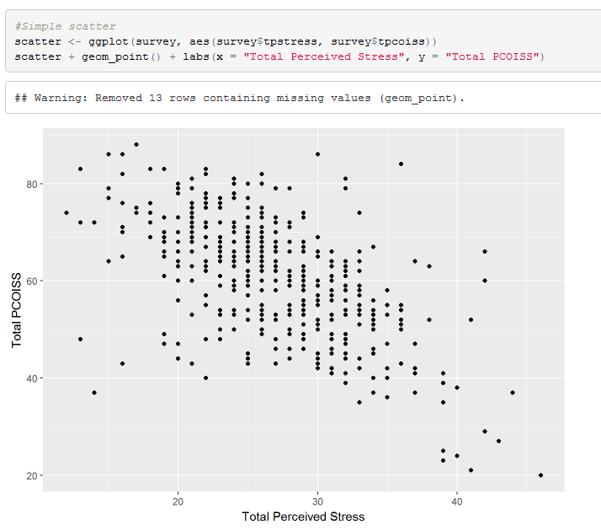
Total PCOISS and Total Perceived Stress

Slide 63
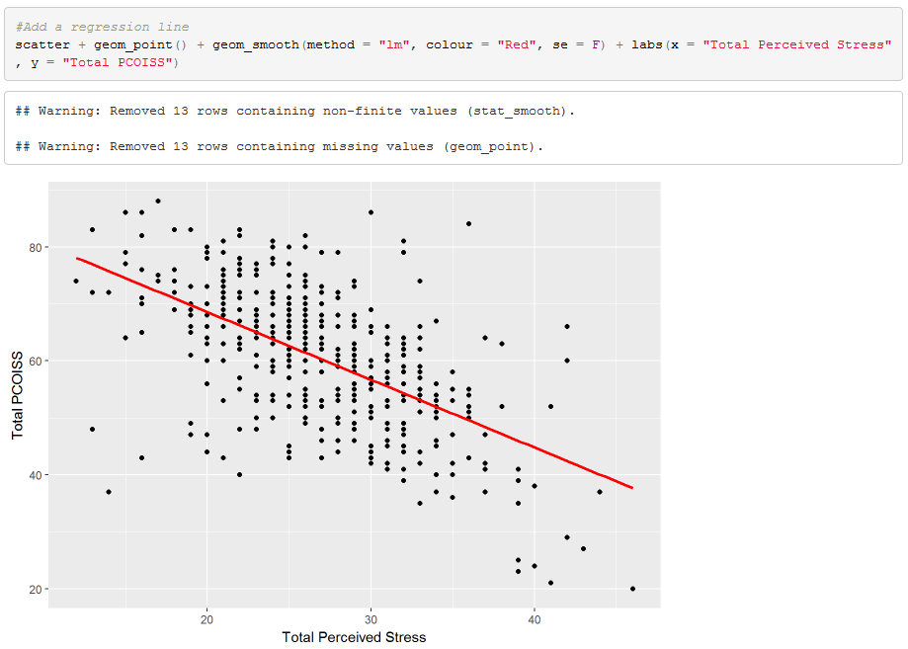
Total PCOISS and Total Perceived Stress

Slide 64
Total PCOISS and Total Perceived Stress
There appears to be negative correlation.
As stress increases, perceived control decreases

Slide 65
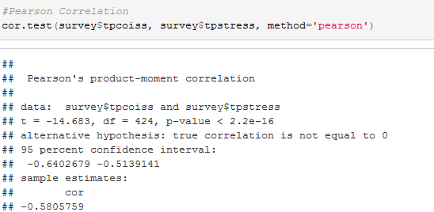
Doing an Correlation in R Total PCOISS, Total Perceived Stress
Pearson’s correlation co-efficient is the statistic
Call it r
Note 1: 2.2e-16 is 2.2 * e to the power of -16 (very small number)
Note 2: You should round your co-efficient to 2 or three decimal places e.g. -0.581

Slide 66
Things to know about the Correlation Co-efficient
It varies between -1 and +1
0 = no relationship
It is an effect size (ignore sign for magnitude of effect)
±.1 = small/weak
±.3 = medium/moderate
±.5 = large/strong
Cohen’s effect size heuristic is standard
Find a book that is respected in your field that discusses this and cite it when stating you used Cohen’s convention
Key Slide

Slide 67
r²
Coefficient of determination, r²
By squaring the value of r you get the proportion of variance in one variable shared by the other.
You can report this if it is relevant to your domain.
In some cases you may report a set of coefficients in a table and discuss the variance in the text.
For our example r² for -.580*-.580=.3364
This means that time Total PCOISS and Total Perceived stress share 33.64% of their variance
Always round up to 2 decimal places
Shared variance

Slide 68
Reporting a Pearson Correlation in words
“The relationship between Total PCOISS (derived from the PCOISS questionnaire) and Total Perceived Stress (derived from the perceived stress questionnaire) was investigated using a Pearson correlation. A strong negative correlation was found (r =-.580, n=424, p<.001).”
NOTE1:
Because the significance is .000 in test results, the convention is to report it as <.001
NOTE2:
N=424 because it does not include missing values

Slide 69
Covariance
Variance tells us by how much scores deviate from the mean for a single variable.
Covariance = Scaled version of variance
Calculate the error between the mean and each observations score for the first variable (x).
Calculate the error between the mean and their score for the second variable (y).
Multiply these error values.
Add these values and you get the cross product deviations.
The covariance is the average cross-product deviations

Slide 70
Covariance
It depends upon the units of measurement.
E.g. The Covariance of two variables measured in Miles might be 4.25, but if the same scores are converted to Km, the Covariance is 11.
One solution: standardise it!
Divide by the standard deviations of both variables.
Create standardised scores
Analyse -> Descriptive Statistics -> Frequencies (check Save as Standardised Scores)
The standardised version of Covariance is known as the Correlation coefficient.

Slide 71
What is a test of hypotheses?
Is it one of the values of the sample statistic that are likely to occur?
A test of hypotheses is a method that uses sample data to decide between two competing claims (hypotheses) about the population characteristic.
Is the value of the sample statistic . . .
a random occurrence due to natural variation?
OR
Is it one that isn’t likely to occur?
a value that would be considered surprising?

Slide 72
Hypothesis Testing
Goal : Make statement(s) regarding unknown population parameter values based on sample data
Elements of a hypothesis test:
Null hypothesis (H₀)
Statement regarding the value(s) of unknown parameter(s).
Typically will imply no association between independent and dependent variables in our theory (will always contain an equality)
Alternative hypothesis (H_{a})
Statement contradictory to the null hypothesis (will always contain an inequality)
Collect data and seek evidence against H₀ as a way of bolstering H_{a} (deduction
Test statistic
Quantity based on sample data and null hypothesis which allows you to determine between null and alternative hypotheses

Slide 73
Hypothesis Testing
Hypothesis may concern an effect (e.g. correlation) in the population or a difference between groups in a population.
The general goal of a hypothesis test is to rule out chance (sampling error) as a plausible explanation for the results from a research study.
All hypothesis testing starts with the null hypothesis : that there is no effect or difference in the population.

Slide 74
Hypothesis statements:
The null hypothesis, denoted by H₀, is a claim about a population characteristic that is initially assumed to be true.
The alternative hypothesis, denoted by H_{a}, is the competing claim.
You are usually trying to determine if this claim is believable.
The hypothesis statements are ALWAYS about the population
– NEVER about a sample!
To determine what the alternative hypothesis should be, you need to keep the research objectives in mind.

Slide 75
The Form of Hypotheses:
Null hypothesis
H₀: population characteristic = hypothesized value
Alternative hypothesis
H_{a}: population characteristic > hypothesized value
H_{a}: population characteristic < hypothesized value
H_{a}: population characteristic ≠ hypothesized value
This one is considered a two-tailed test because you are interested in both direction.
The null hypothesis always includes the equal case.
This hypothesized value is a specific number determined by the context of the problem
This sign is determined by the context of the problem.
Notice that the alternative hypothesis uses the same population characteristic and the same hypothesized value as the null hypothesis.
These are considered one-tailed tests because you are only interested in one direction.

Slide 76
Our example
H0: There is no relationship between Total PCOISS and Total Perceived Stress
Ha: There is a relationship between Total PCOISS and Total Perceived Stress
Two-tailed hypothesis

Slide 77
When you perform a hypothesis test you make a decision:
reject H₀ or fail to reject H₀
When you make one of these decisions, there is a possibility that you could be wrong!
That you made an error!
Each could possibly be a wrong decision; therefore, there are two types of errors.

Slide 78
Type I error
The error of rejecting H₀ when H₀ is true
The probability of a Type I error is denoted by α.
α is called the significance level of the test
Key Slide
This is the lower-case Greek letter “alpha”.

Slide 79
Type II error
The error of failing to reject H₀ when H₀ is false
The probability of a Type II error is denoted by β
Key Slide
This is the lower-case Greek letter “beta”.

Slide 80
Here is another way to look at the types of errors:
Suppose H₀ is true and we fail to reject it, what type of decision was made?
Suppose H₀ is false and we reject it, what type of decision was made?
Suppose H₀ is true and we reject it, what type of decision was made?
Suppose H₀ is false and we fail to reject it, what type of decision was made?
 | H₀ is true | H₀ is false
Reject H₀
Fail to reject H₀
Type I error
Correct
Type II error
Correct

Slide 81
P-value, α – statistical significance
Key Slide
A probability measure of evidence about H_{0.}
Put simply it is the probability, given the null hypothesis is true, that the results could have been obtained purely on the basis of chance alone.
The probability (under presumption that H₀ true) the test statistic equals observed value or value even more extreme predicted by H_{a}
The P-value allows us to answer the question:
Do our sample results allow us to reject H₀ in favour of H_{a}?
If that probability (p-value) is small, it suggests the observed result cannot be easily explained by chance

Slide 82
Statistical Significance
Key Slide
Working with random samples can never have 100% certainty that findings we derive from the sample will reflect real differences in the population as a whole.
Convention is that (for your field of study) there is an accepted level of probability such that it is considered so small that the finding from your sample is unlikely to have occurred by chance or sampling error.
Normally, that line is drawn at p=0.05 or p=0.01.
In other words, when a statistical test tells us that the finding has less than a 5% or 1% chance of occurring due to sampling error then we tend to conclude that we can be sufficiently confident that the finding is therefore likely to reflect a ‘real’ characteristic of the population as a whole.
When this occurs, you can say that your finding is statistically significant.

Slide 83
Statistical Significance
A range of statistical tests can be used
Each will tell you how likely it is that a finding you get from your sample would occur simply by chance if no such difference actually existed in the population as a whole
ie. the probability that your finding is simply a fluke occurrence deriving from the random selection of your sample.

Slide 84
One-tailed and Two-tailed Tests
P values are calculated for you are based upon a non-directional alternative hypothesis
Two-tailed tests
In other words
While you state that a difference may exist between men and women, you don’t state what that difference is i.e. is it likely to be more men than women or more women than men?

Slide 85
One-tailed and Two-tailed Tests
If you can be more specific prior to analysing your data, usually on the basis of a theory you may have, and thus state a directional hypothesis then you can cut the probability calculated for you in half.
This is called a one-tailed test.
Thus if your statistical test gives you a value of p=0.07 then, if you have stated a directional hypothesis and your findings confirm this, then you can quote the probability as p=0.035
(which then may become statistically significant depending on the level you are working with).

Slide 86
Hypothesis Testing
You start with the assumption (the 'null hypothesis' H₀) that there are no differences or relationships in the population as a whole.
You then state an alternative hypothesis (H_{A}) that there is a difference or a relationship.
You select a sample and find a difference/relationship in it.
You can then use a variety of tests for statistical significance to work out the probability of the difference/relationship you have found in your sample simply occurring by chance.

Slide 87
Hypothesis Testing
Using the standard level accepted by your domain (e.g. p ≤0.05 or p ≤0.01)
If the probability less than this value then you reject the null hypothesis and thus accept the alternative hypothesis and you can state that your findings are 'statistically significant'.
If the probability is greater this value then you conclude that there is no evidence to reject the null hypothesis and your findings are not ‘statistically significant’.
N.B This is different from concluding that you have evidence to accept the null hypothesis. In these cases, your findings are said to be ‘not significant’.
Caveat
If we get a p-value of 0.051 should we accept the null hypothesis?
Should we reject the null hypothesis if we get a p-value of 0.049?
Need to allow for some flexibility in interpretation

Slide 88
Accepting and Rejecting Hypotheses
A non-statistically significant test result does not mean that the null hypothesis is true
A significant result does not mean that the null hypothesis is false
Key Slide

Slide 89
Our Example -Doing a Correlation
This significance value tells us that the probability of this correlation being due to random chance is very low (close to zero in fact).
Hence, we can have confidence that this relationship is genuine and not a chance result.

Slide 90
P-value
If no decision needed, report and interpret P-value
If decision needed, select a cutoff point (such as 0.05 or 0.01) and reject H0 if P-value ≤ that value

Slide 91
Reporting the results
If you wish to report in text
“The relationship between Total PCOISS (derived from the PCOISS questionnaire) and Total Perceived Stress (derived from the perceived stress questionnaire) was investigated using a Pearson correlation. A strong negative correlation was found (r =-.58, n=424, p<.001).”
Key Slide
NOTE1:
Because the significance is .000 in test results, the convention is to report it as <.001
NOTE2:
N=424 because it does not include missing values

Slide 92
Things to know about the Correlation Co-efficient
It varies between -1 and +1
0 = no relationship
It is an effect size (ignore sign for magnitude of effect)
±.1 = small/weak
±.3 = medium/moderate
±.5 = large/strong
Cohen’s effect size heuristic is standard

Slide 93
Things to know about the Correlation Co-efficient
Coefficient of determination, r²
By squaring the value of r you get the proportion of variance in one variable shared by the other.
You can report this if it is relevant to your research.
In some cases you may report a set of coefficients in a table and discuss the variance in the text.
What does this mean?
In our example r= r =-.58 so r²=0.3364=33.64%
What does this mean?
Our concepts have 33.64% of their variation in common

Slide 94
Things to know about the Correlation Co-efficient
Significance of all co-efficient and covariance depends on the p-value (significance value of the test)

Slide 95
Correlation and Causality
The third-variable problem:
Causality between two variables cannot be assumed because there may be other measured or unmeasured variables affecting the results.
In our example
Perceived stress does relate significantly to perception of control
There may be other factors that are influencing perception of control.
And some of these variables may not have been measured by the researcher.

Slide 96
Correlation and Causality
Direction of causality:
Correlation coefficients say nothing about which variable causes the other to change.
The correlation coefficient doesn’t indicate in which direction causality operates.
So, although it is intuitively appealing to conclude that perceived stress causes perceived control to change, there is no statistical reason why perceived control cannot cause perceived stress.
This is where your knowledge of the constructs and existing theories in your area come in to play
You interpret your statistical findings through the lens of your subject area
Why including relevant background and related research is important in your reporting

Slide 97
Statistical v Practical Significance
A small correlation co-efficient can reach statistical significance.
This doesn’t mean anything practically.
Need to consider both the co-efficient and the amount of shared variance (squaring the co-efficient) .
E.g. a coefficient of 0.2 explains 4% of the shared variance
Need also to consider other research into the area and compare your findings with those
Even though your research explains only a small amount of the variance it may be more than others have found (or less).

Slide 98
Sample size and correlation
In small samples (e.g. n=30) you may have moderate correlation that does not reach statistical significance
In larger samples (n=100+) small correlations may reach statistical significance
You need to report statistical significance but also the strength of the relationship and the amount of shared variance.

Slide 99
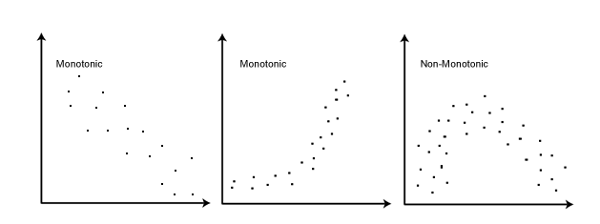
Spearman (Non-parametric)
Doesn’t require normality
Requires independent observations
Use when assumptions of Pearson are violated or when data is not scale
Spearman - Requires a monontonic relationship – as one variable increases, so does the other or as one increases the other decreases

Slide 100
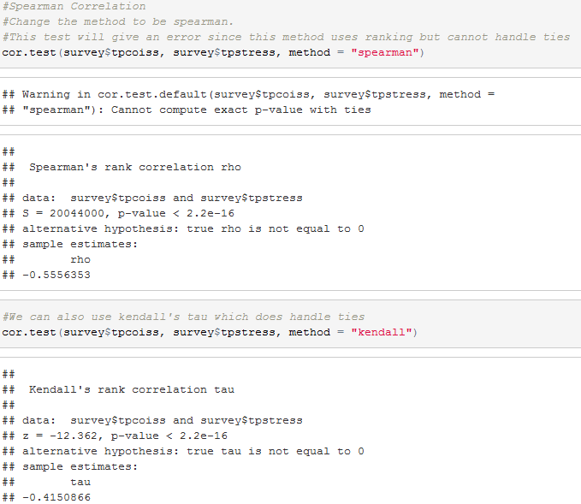
Spearman Correlation in R
Spearman’s Rho is the statistic
Kendall’s Tau is the statistic

Slide 101
Reporting Spearman and Kendall in words
As you would for Pearson except make sure you cite the correct test and give the correct statistic
Spearman
Spearman’s rho
or r_{s}
or the Greek letter ρ
Kendall
Kendall’s tau
Kendall's tau-b
τ_{b}

